Slide 1



Data Engineering 1:Big Data Databases
By Team 9,
Anton J Vikranth
Praneet Patnaik
Gaurav Naik
Pavankumar Umesh Managoli

Slide 2
Websites Scraped
MyAnimeList
Anime News Network
AniDB
MyAnimeList is a comprehensive online database and community platform that allows users to track, rate, and review anime and manga. It serves as a go-to resource for anime enthusiasts, providing information on series, characters, and industry new.
Anime News Network is a leading online source for anime and manga news, reviews, and industry insights. Providing up-to-date information and editorials, it serves as a go-to platform for enthusiasts and industry professionals alike, offering comprehensive coverage of the anime world.
AniDB is an extensive anime database and community-driven platform that facilitates tracking, rating, and discovering anime series and movies. With detailed information on episodes, characters, and user-generated content, it caters to anime fans seeking a thorough and collaborative database experience.

Slide 3
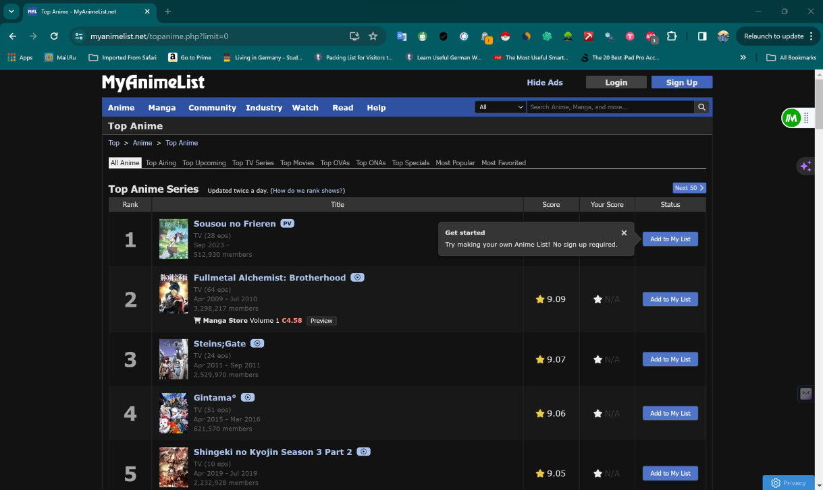
MyAnimeList

Slide 4

Anime News Network

Slide 5
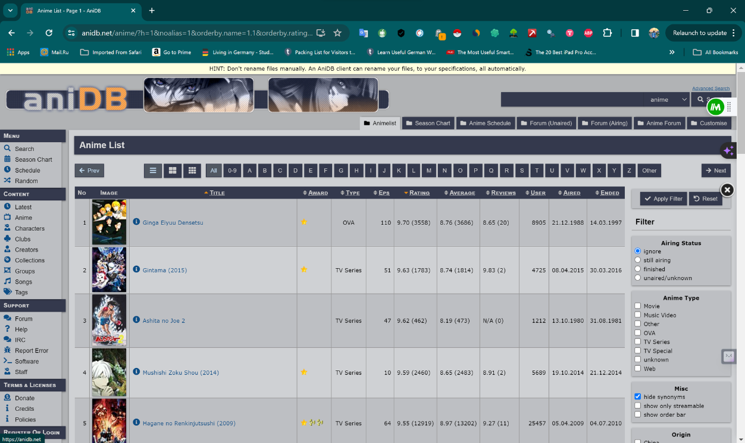
AniDB

Slide 6
Data Points
MyAnimeList
Synonyms, Japanese, English, Types, Episode, Status, Aired, Premiered, Broadcast, Producers, Licensors, Studios, Source, Genre, Theme, Demographic, Rating, Scored, Ranked, Popularity, Members, Favorites
AnimeNewsNetwork
Images of animes were scraped from the website
AniDB
Anime Title, Anime Type, Episode Count, Rating, Average Rating, Review Rating

Slide 7
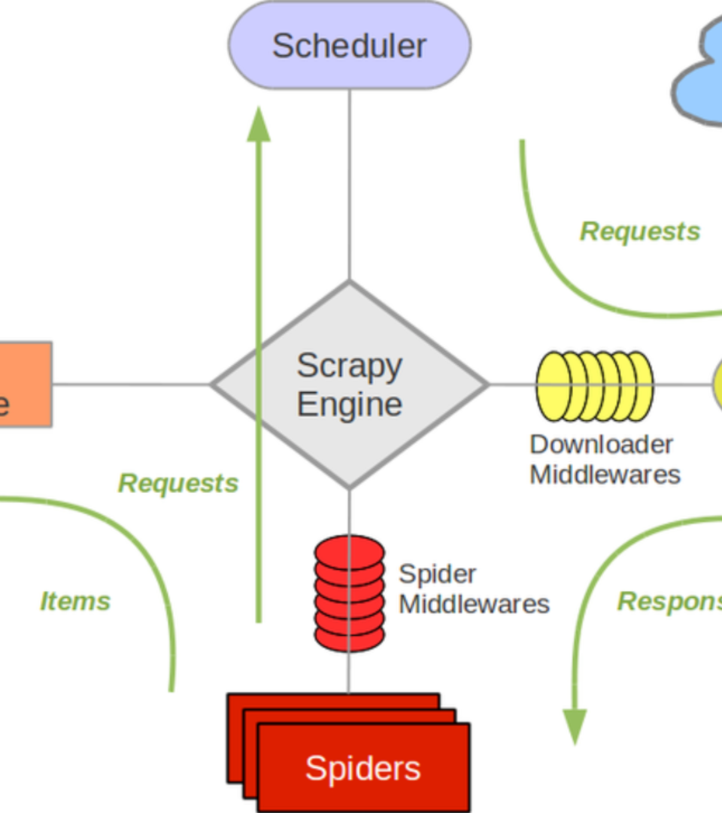
Tool used for crawling MyAnimeList
Scrapy used for crawling from websites

Slide 8
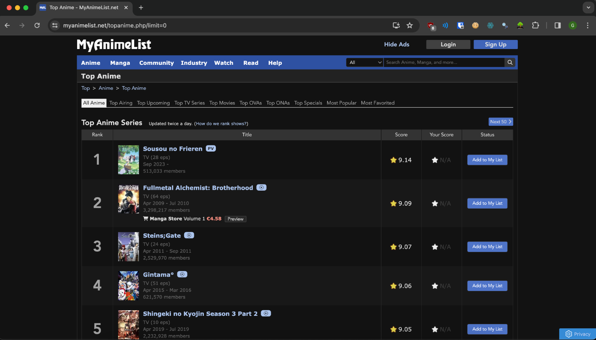
Crawling MyAnimeList - first 50

Slide 9
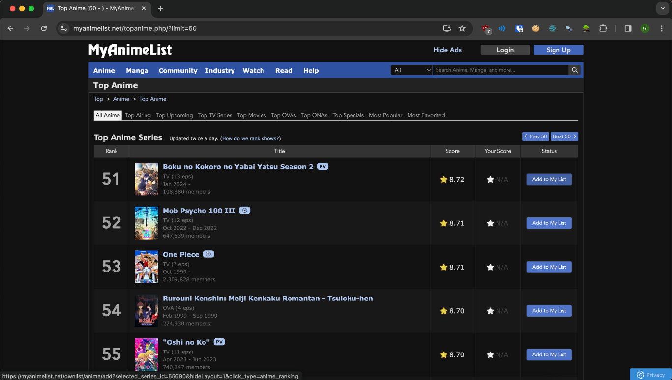
Crawling MyAnimeList - next 50

Slide 10
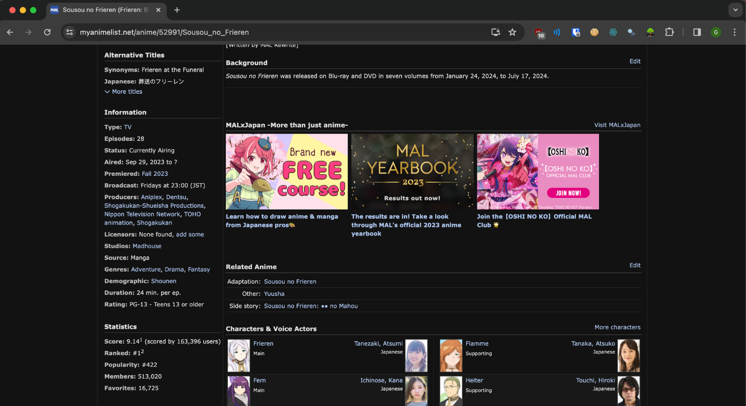
Scraping MyAnimeList - each item

Slide 11
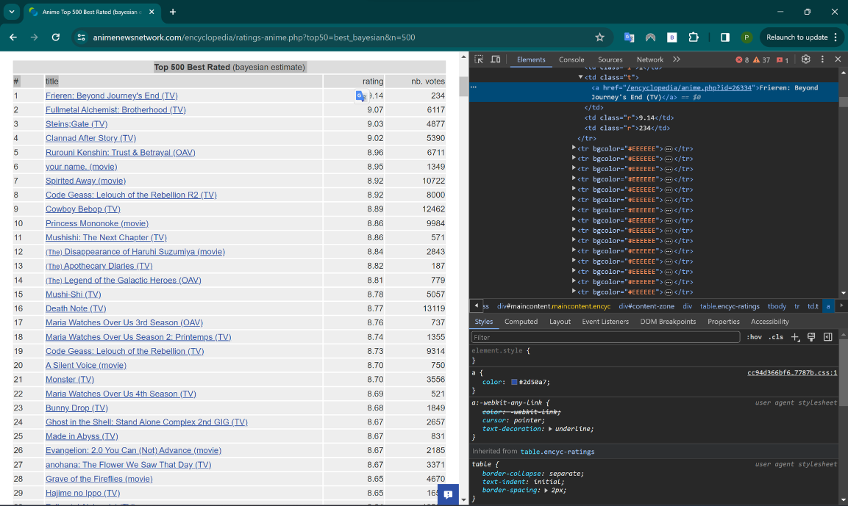
Crawling AnimeNewsNetwork-first

Slide 12
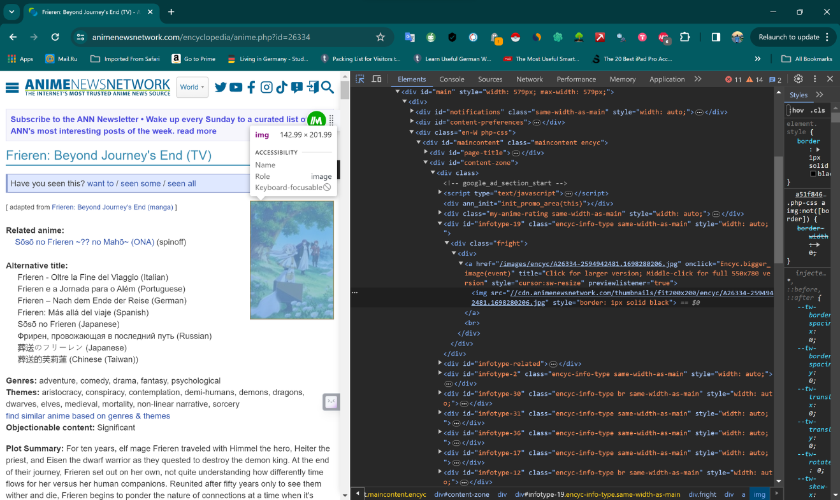
Crawling AnimeNewsNetwork-each

Slide 13
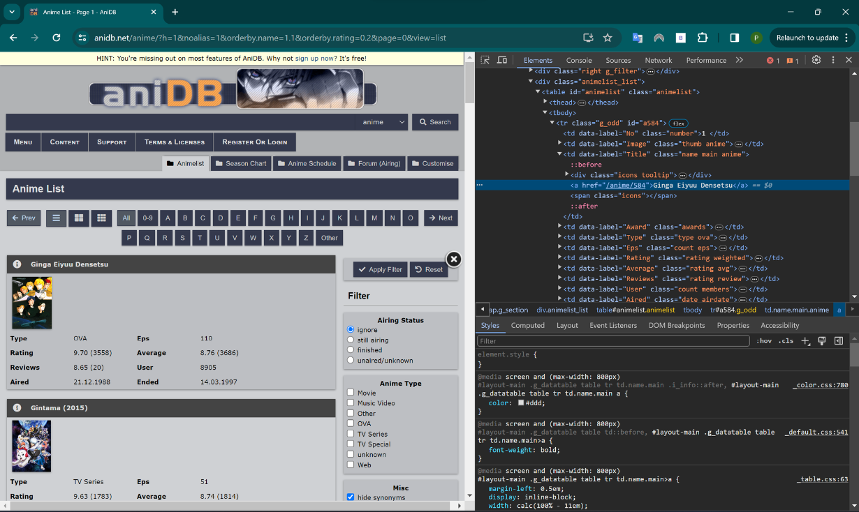
Crawling AniDB- first 30

Slide 14
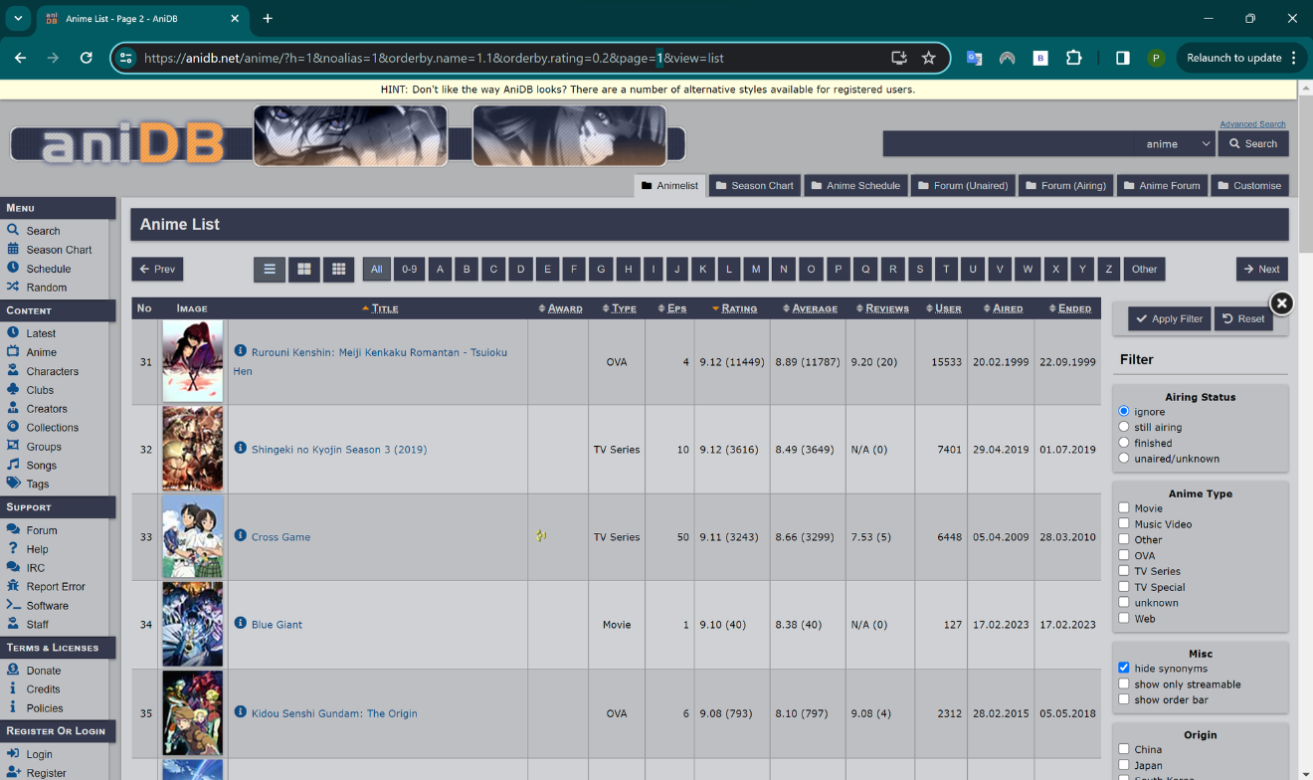
Crawling AniDB- next 30

Slide 15
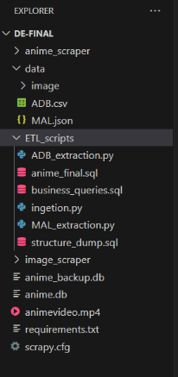
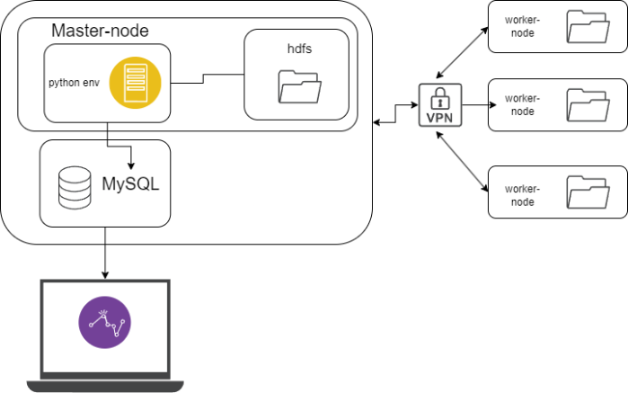
Project setup

Slide 16
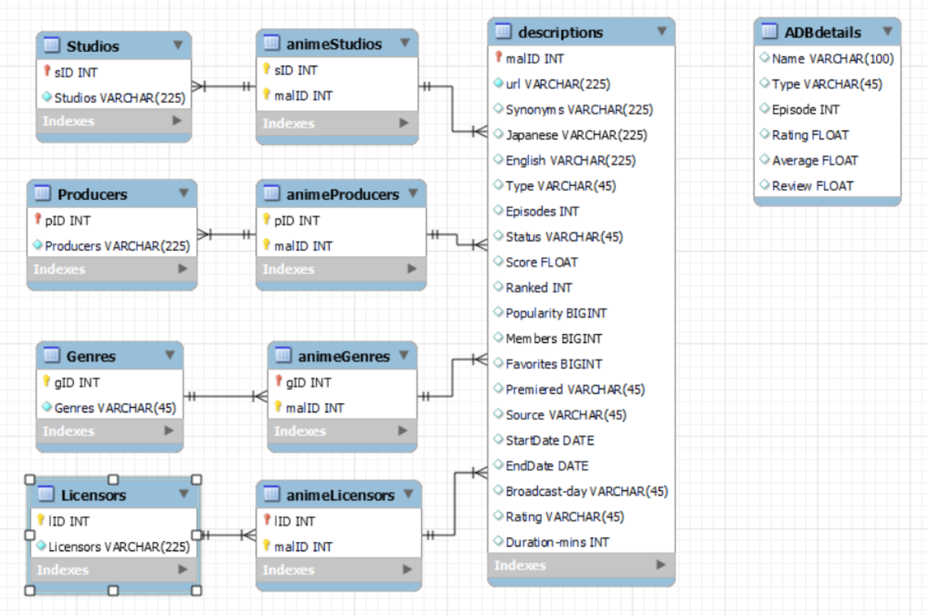
Database schema

Slide 17
Business Queries - 1
Query to highlight versatile anime producers with multiple-genre involvement, sorting by average popularity.
SELECT Producers.Producers, COUNT(DISTINCT Genres.gID) AS NumberOfGenres, AVG(descriptions.Popularity) AS AveragePopularity FROM Producers JOIN animeProducers ON Producers.pID = animeProducers.pID JOIN descriptions ON animeProducers.malID = descriptions.malID JOIN animeGenres ON descriptions.malID = animeGenres.malID JOIN Genres ON animeGenres.gID = Genres.gID GROUP BY Producers.Producers HAVING NumberOfGenres > 1 ORDER BY AveragePopularity DESC;

Slide 18
Business Queries - 2
Query to Find Average Score for Each Genre:
SELECT g.Genres, AVG(d.Score) AS AverageScore
FROM anime.Genres g
JOIN anime.animeGenres ag ON g.gID = ag.gID
JOIN anime.descriptions d ON ag.malID = d.malID
GROUP BY g.Genres
ORDER BY AverageScore DESC;

Slide 19
Business Queries - 3
Query to Find Studios with the Most Released Episodes:
SELECT s.Studios, SUM(d.Episodes) AS TotalEpisodes
FROM anime.Studios s
JOIN anime.animeStudios ast ON s.sID = ast.sID
JOIN anime.descriptions d ON ast.malID = d.malID
GROUP BY s.Studios
ORDER BY TotalEpisodes DESC

Slide 20
Business Queries - 4
Query to Retrieve Anime with a Certain Producer:
SELECT d.*, p.Producers
FROM anime.descriptions d
JOIN anime.animeProducers ap ON d.malID = ap.malID
JOIN anime.Producers p ON ap.pID = p.pID
WHERE p.Producers = 'Madhouse';

Slide 21
Business Queries - 5
Retrieve Anime with Specific Genre (e.g., 'Action'):
SELECT d.*, g.Genres
FROM anime.descriptions d
JOIN anime.animeGenres ag ON d.malID = ag.malID
JOIN anime.Genres g ON ag.gID = g.gID
WHERE g.Genres = 'Action';

Slide 22
Business Queries - 6
Query to Find Active Studios with Most Anime:
SELECT Studios.Studios, COUNT(animeStudios.malID) AS AnimeCount
FROM anime.Studios J
OIN anime.animeStudios ON Studios.sID = animeStudios.sID
GROUP BY Studios.Studios ORDER BY AnimeCount DESC;

Slide 23
Business Queries - 7
Query to Find Highest Rated Animes (Rating greater than 8 )
SELECT * FROM ADBdetails AS a
WHERE a.RATING > 8
ORDER BY a.RATING DESC, a.EPISODE;

Slide 24
Thank You

